Slide 1
NLI Data Sanity Check:
Assessing the Effect of Data Corruption on Model Performance
Talman, Aarne, et al. "NLI Data Sanity Check: Assessing the Effect of Data Corruption on Model Performance." arXiv preprint arXiv:2104.04751 (2021).
Guo Zikun

Slide 2
1 Introduction
Pre-trained neural language models give high performance on natural language inference (NLI) tasks. But whether they actually understand the meaning of the processed sequences remains still unclear. A new test suite which allows to assess whether a dataset a good testbed for evaluating the models’ meaning understanding capabilities was proposed.
Notes:
预训练的神经语言模型在自然语言推理 (NLI) 任务上具有很高的性能。 但他们是否真正理解处理过的序列的含义仍不清楚。 提出了一种新的测试套件，可以评估数据集是否是评估模型含义理解能力的良好测试平台。

Slide 3
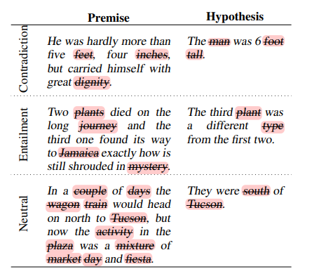
1 Introduction
Notes:
所以在这里给大家举个例子，关于什么是句子损坏（corruption），这三个数据来自MNLI数据集，是已经把所有名词删除的
第一个选项是关于矛盾的（Contradiction）意思就是当我删除全部的名词以后，句子就会变得矛盾（Contradiction）
第二个选项是关于蕴含（Entailment）：意思就是当我删除全部名词以后，依然蕴含（Entail）之前的含义
第三个选项是关于中性的（Neutral）：意思就是当我删除全部名词以后，句子原本表达（expression）是中性（Neutral）的

Slide 4
1 Introduction
Goal :
contribute a new suite of diagnostic tests that can be used to assess the quality of an NLU benchmark.
Decrease in performance --expected.
High performance -- indicate the presence of biases and other artefacts in the dataset which guide models’ prediction.

Slide 5
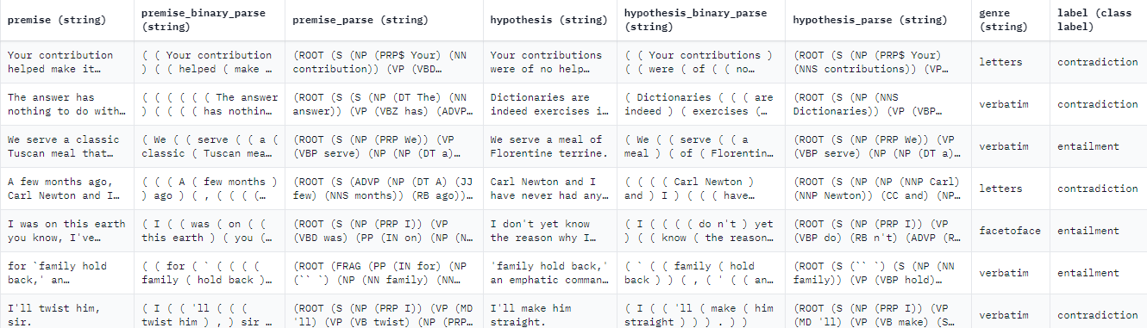
2 Datasets
MULTI_NLI :
Notes:
在多类型自然语言推理语料库上进行我们的实验。 MNLI 包含标记为“entail ment”、“contradiction”和“neutral”的人工书写的句子对。 语料库包括来自十种不同类型的英语书面和口语的句子对

Slide 6
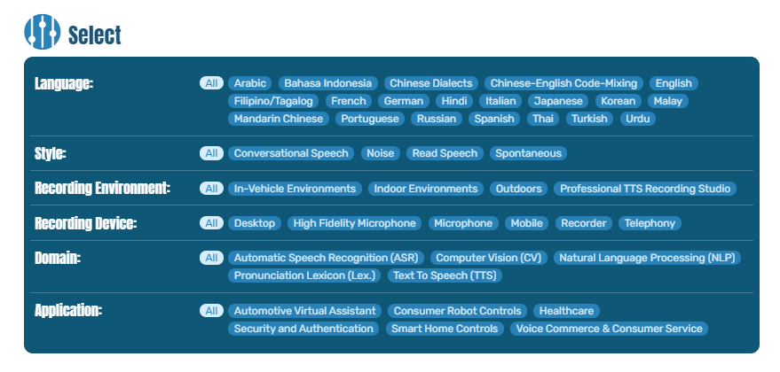
2 Datasets
ANLI :
Notes:
对抗性 NLI 基准 (ANLI) 专门门设计用于解决以前 NLI 的一些缺点数据集。 ANLI包含三个数据集（轮次），R1、R2 和 R3。 每个数据集都是使用手动和模型在环方法收集的，并且它们的难度和复杂性正在逐渐增加。
The Adversarial NLI Benchmark (ANLI) is specifically designed to solve some of the shortcomings of previous NLI datasets. ANLI contains three data sets (rounds), R1, R2 and R3. Each data set is collected using manual and model-in-the-loop methods, and their difficulty and complexity are gradually increasing.

Slide 7
3 Systematic NLI Data Corruption
MNLI CORRUPT-TRAIN & CORRUPT-TEST ：
Removing words of specific word classes from the MNLI-matched development dataset, or keeping these and removing the rest.
Combine the original MNLI and the corrupted training datasets together.
Notes:
我们通过对原始数据集应用一组受控转换来创建MNLI训练和评估数据的修改版本,被称之为s MNLI CORRUPT-TRAIN and CORRUPT-TEST

Slide 8
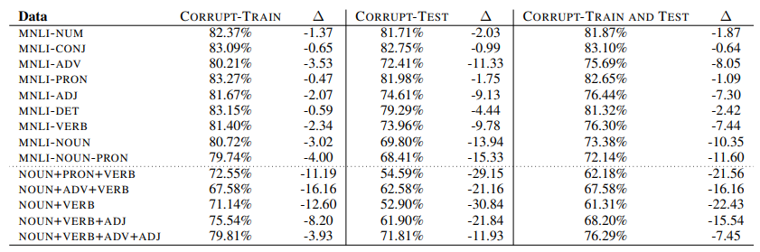
4 Evaluation

Slide 9

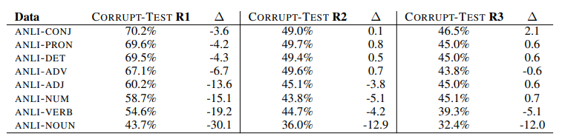
4 Evaluation
Notes:
R1 和 R2 的上下文由从维基百科中检索的句子组成。 在 R3 中，上下文是从维基百科，新闻（常见爬行），小说，儿童书籍测试 (CBT)，从 WikiHow 中提取的正式口语文本和程序文本。R1 和 R2 的上下文由从维基百科中检索的句子组成。 在 R3 中，上下文是从维基百科，新闻（常见爬行），小说，儿童书籍测试 (CBT)，从 WikiHow 中提取的正式口语文本和程序文本。

Slide 10
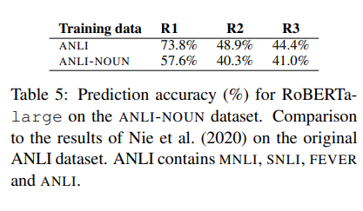
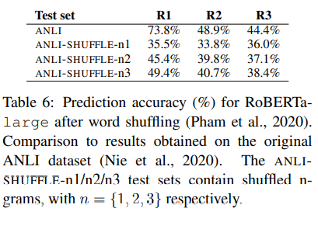
4 Evaluation

Slide 11
4 Discussion
Neural network models that beat human performance in NLU tasks actually understand language is currently much debated.
BERT performs surprisingly well in these experiments. This indicates that rather than understanding the meaning of the sentences and the semantic relationship between them, the models are able to pick up on other cues from the data that allow them to make correct predictions.

Slide 12
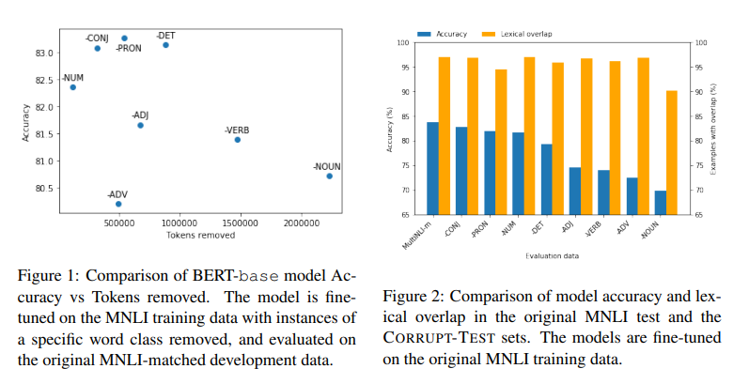
4 Discussion
Notes:
删除的建议

Slide 13
4 Conclusion
Data corruption is an efficient way to estimate dataset quality and their potential to reflect the real language understanding capabilities of the models.
CORRUPT methodology can successfully identify datasets of high or low quality and can be used for assessing the quality of existing benchmarks used by the community and interpreting the results.
Notes:
结论

